Slide 1
ENGI 301 Mechanical Split Flap Timer/Stopwatch Proposal
Mon 09/25
Peter Tizora

Slide 2
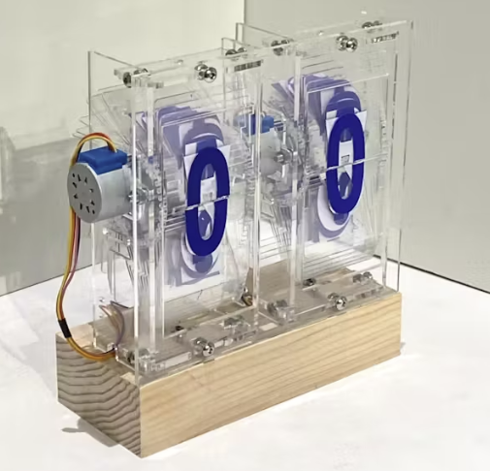
Background Information
I am proposing to build a mechanical split flap device that can display a timer and stopwatch
- https://www.hackster.io/jyx1/engi-301-split-flap-ddebac
- https://scottbez1.github.io/splitflap/
- https://github.com/scottbez1/splitflap
My intended design has 4 stepper motors to provide the torque for flipping the flaps. There are four split flaps: the left two for displaying time elapsed. Unlike the original project mine will also include a digital LCD display for user output prompts.

Slide 3
My Story
My goal when I was looking for a project was to have something that had an interesting mechanical aspect and quite a regular software and electrical component. As a Mechanical Engineer major I was captivated by the mechanical intricacies of the split flap display. Even more intriguing was the perfectly timed rotation of the stepper motors to display the different characters. Also the flaps made very satisfying tapping sounds as they flipped around.

Slide 4
System Block Diagram
SPI Screen
GPIO
PWM
Stepper Motor
Buttons [input]
GPIO
PWM
Stepper Motor
PWM
Stepper Motor
LEDs [status]
GPIO

Slide 5
Power Block Diagram
SPI Screen
1.8 V
3.3 V
Stepper Motor
Buttons [input]
1.8 V
3.3 V
Stepper Motor
3.3 V
Stepper Motor
LEDs [status]
1.8 V

Slide 6
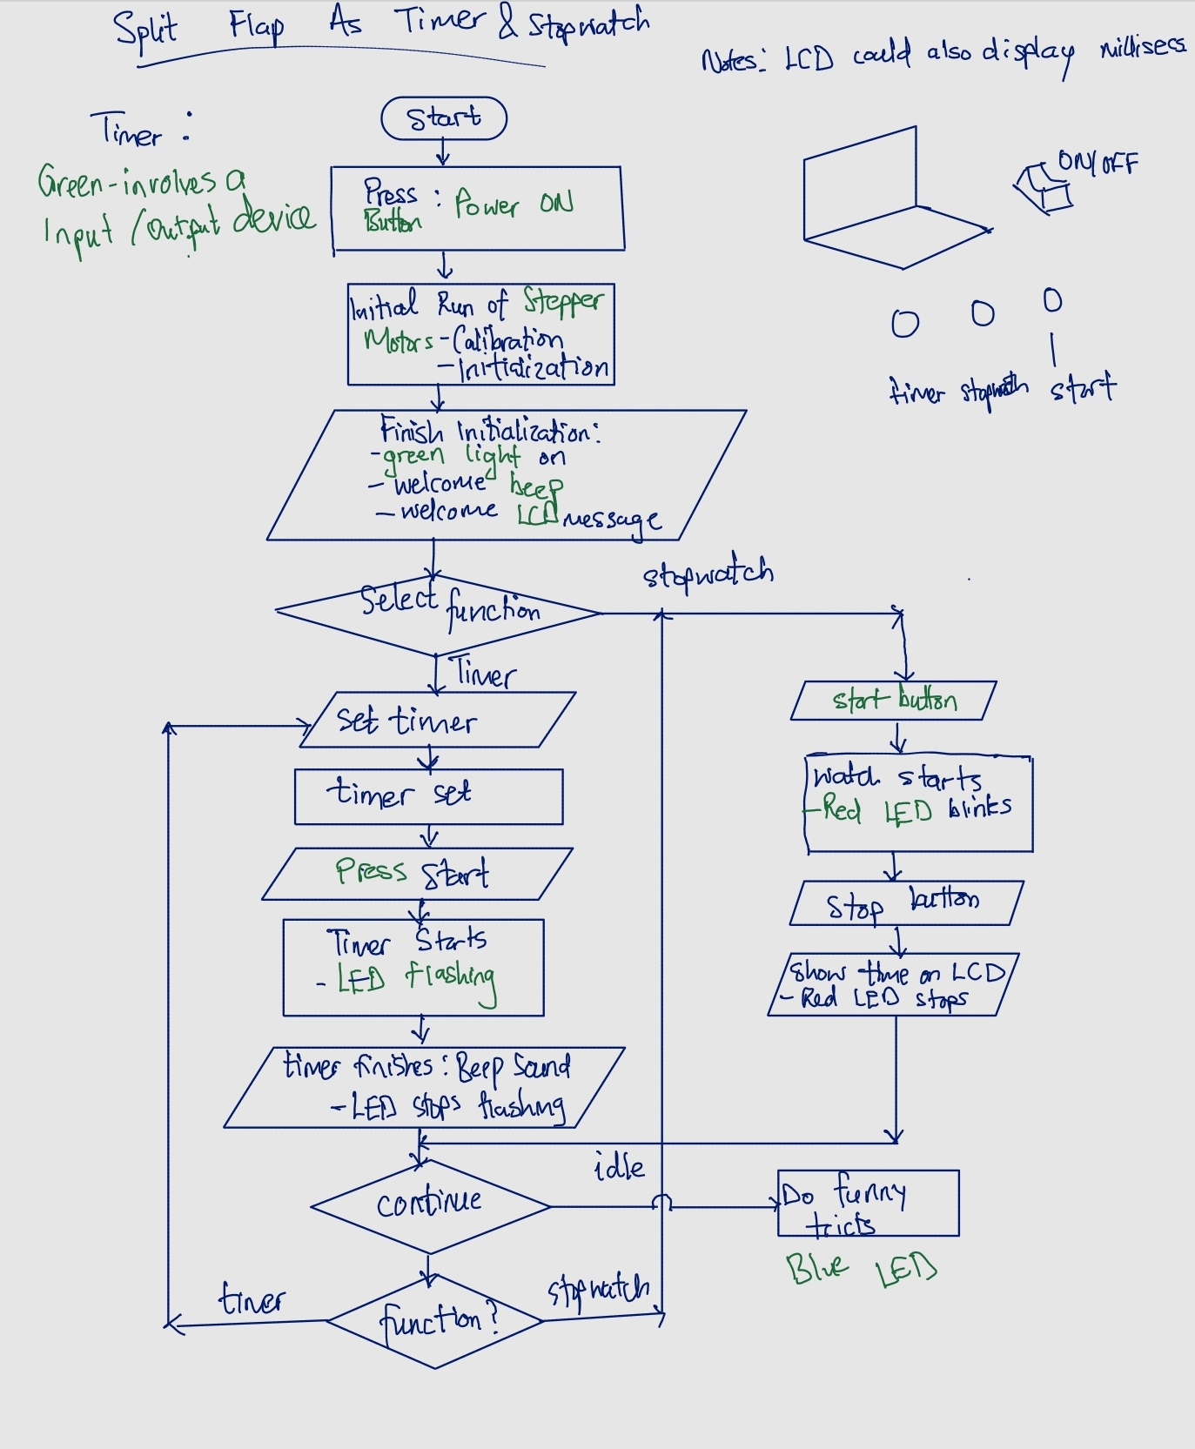
Overall System Block Diagram

Slide 7
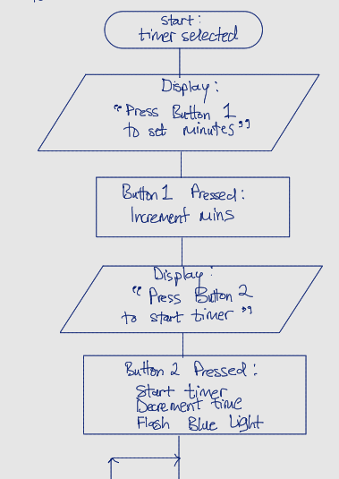
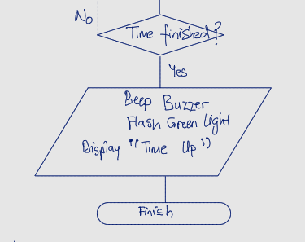
Timer Block Diagram

Slide 8
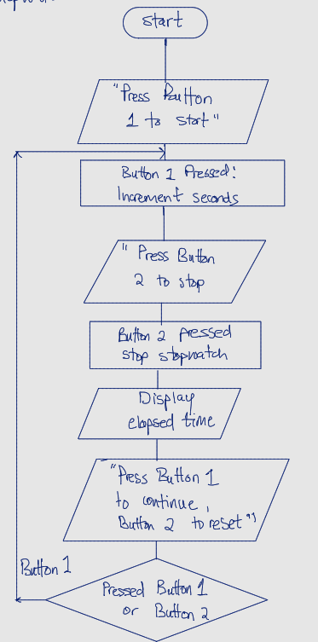
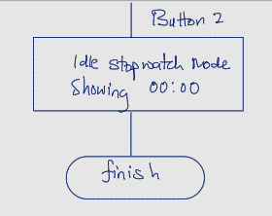
Stopwatch Block Diagram

Slide 9

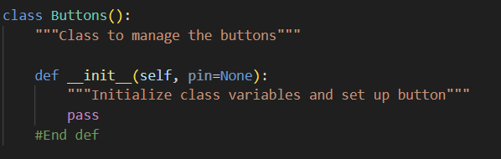
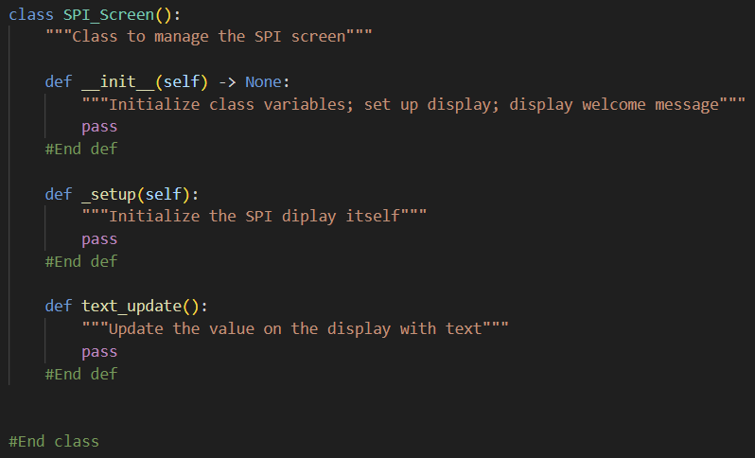

Python Classes and Functions

Slide 10
Components / Budget
Component | Need to Buy | Cost
Stepper Motor https://www.amazon.com/dp/B0B38H2ZMR | 3 | 20
Stepper Motor Driver https://www.amazon.com/HiLetgo-Stepstick-Stepper-Printer-Compatible/dp/B07BND65C8 | 3 | 5
Level Shifter https://www.amazon.com/EPLZON-Converter-Bi-Directional-Compatible-Raspberry/dp/B09R1QG957 | 3 | 5
SPI Screen https://www.adafruit.com/product/1770 | 1 | 30
Acrylic https://oedk.wildapricot.org/order | 2 | 14

